Slide 1

MOVIE RECOMMENDATION SYSTEM
APEKSHA GAONKAR
PES1201701562
ASTHA SINGH
PES1201701156
SHAMITHA S
PES1201701655

Slide 2
A RECOMMENDER SYSTEM PREDICTS THE LIKELIHOOD THAT A USER WOULD PREFER AN ITEM

Slide 3
OUTLINE :
Introduction to Recommendation system
Collaborative filtering
Neural collaborative filtering

Slide 4
Recommender System
Recommender system is widely used in many online services, including E-commerce, online news and social media sites to increase their revenue by recommending user what they may like depending on what they have purchased or searched for earlier.
In a very general way,recommender systems are algorithms aimed at suggesting relevant items to users (items being movies to watch,text to read,products to buy or anything else depending on industries).

Slide 5
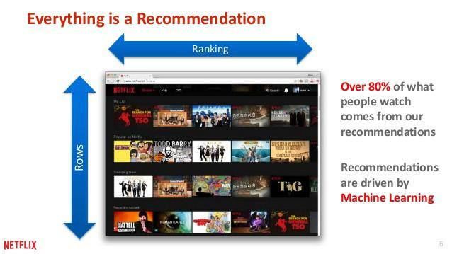

Slide 6
There are two methods that can be adopted to implement recommender systems:
Content based Recommendation
Collaborative Filtering Method

Slide 7
1: Content based filtering:
In this we try to build a model ,based on the available “features “,that explain the observed user-movie interactions .
This method is not very effective as this type of filtering compels the user to describe the features (mystery,action,romance) of the movie since only then the movie will be classified and thus way another movie can be recommended based on the users highest rating to a movie of a particular genre/feature.

Slide 8
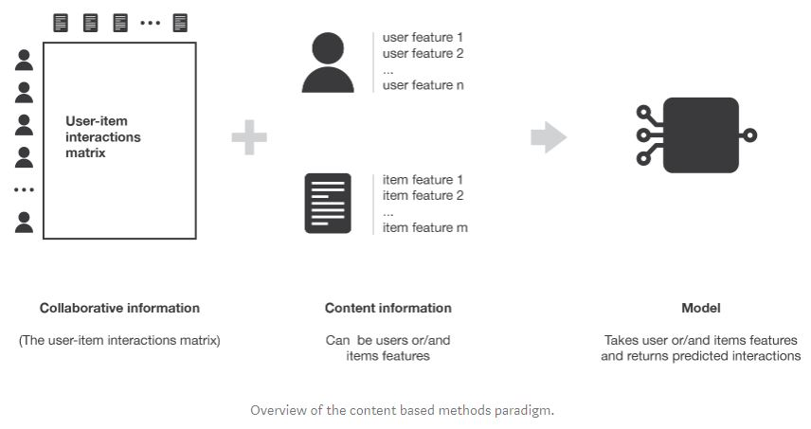

Slide 9
2: Collaberative filtering :
It is based only on the user-movie interaction matrix.
This method is effective because we can predict the features of the movie based on the ratings of the user or predict the ratings of the user given the feature of the movie.
Example: Ratings are given and we need to predict the feature of the movie.
It is mainly of two type : 1 : Memory based approch
2: Model based approch

Slide 10
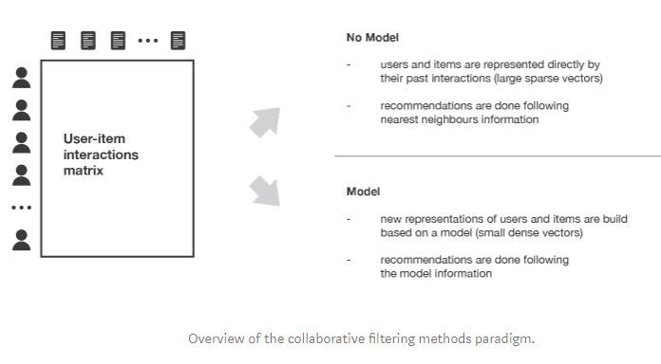

Slide 11
COLLABORATIVE FILTERING
The underlying assumption of the collaborative filtering approach is that if a person A has the same opinion as a person B on an issue, A is more likely to have B’s opinion on a different issue than that of a randomly chosen person.
The idea of filtering patterns by collaborating multiple viewpoints is why it is called collaborative filtering

Slide 12
How Does Collaborative Filtering work?

Slide 13
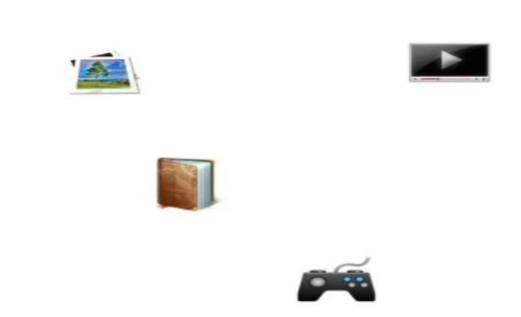

Slide 14
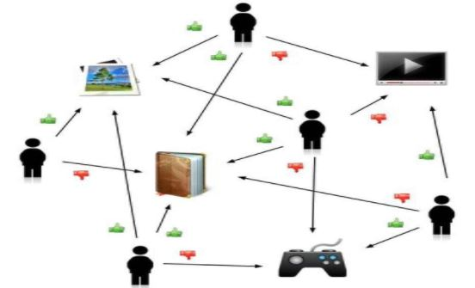

Slide 15
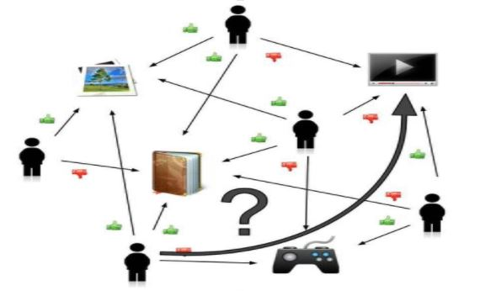

Slide 16
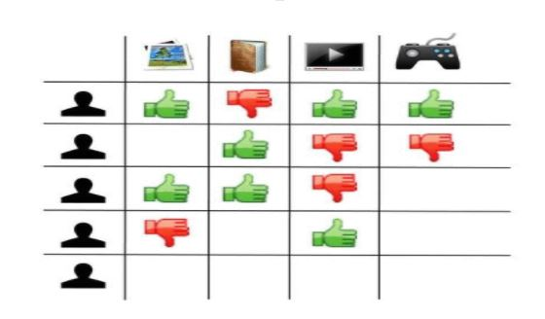

Slide 17
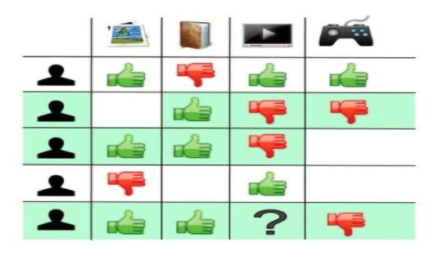

Slide 18
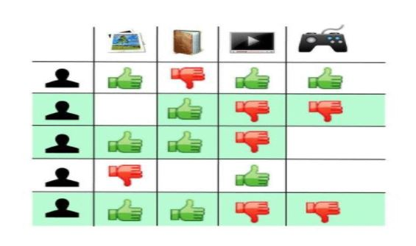

Slide 19
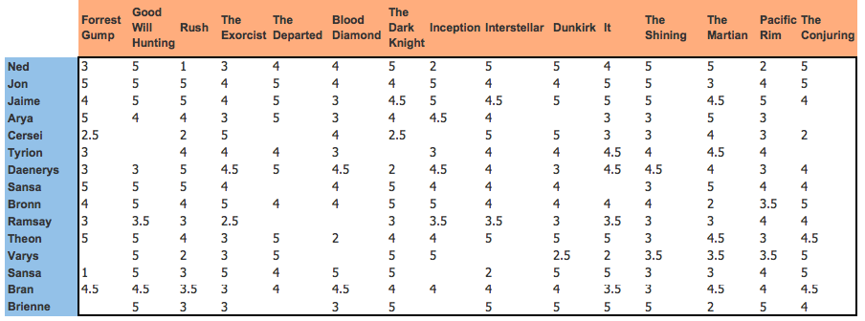
User - Movie Interaction Matrix:
a
we have data on the ratings given by different users for different movies on a scale of 0–5. Blank cell means the user hasn’t rated the movie. Our goal is to model this system as closely as possible.

Slide 20
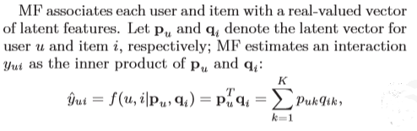
Matrix factorisation
Among the various collaborative filtering techniques, Matrix Factorization is the most popular one, which projects users and items into a shared latent space.Thereafter a user’s interaction on an item is modelled as the inner product of their latent vectors.

Slide 21
NEURAL BASED COLLABORATIVE FILTER
Model Based Approach

Slide 22
NCF models the user and item interaction in the latent space effectively with the neural network.
The inner product, which simply combines the multiplication of latent features linearly, may not be sufficient to capture the complex structure of user interaction data.
By replacing the inner product with a neural architecture that can learn an arbitrary function from data, we present a general framework named Neural network based Collaborative Filtering (NCF).

Slide 23
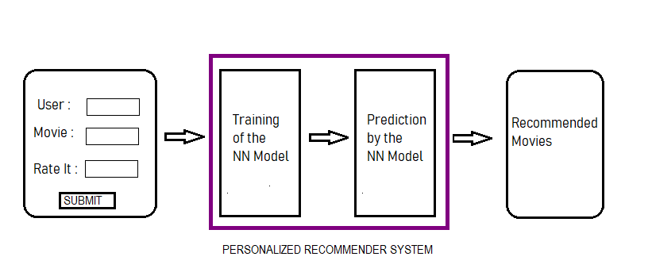
OVERVIEW MODEL OF THE SYSTEM :

Slide 24


Generalized Matrix Factorization (GMF)
MF can be interpreted as a special case of our NCF framework .
Mapping function of the ﬁrst neural CF layer :
where p(u)=user latent vector and q(i)=movie latent vector
= element-wise product of vectors
Vector to the output layer :
Where h=edge weights of the output layer and aout= activation function
If h is unitary and aout is a linear function than GMF=MF .
if h to be learnt from data and by using a non-linear sigmoidal function as aout we will get GMF.

Slide 25
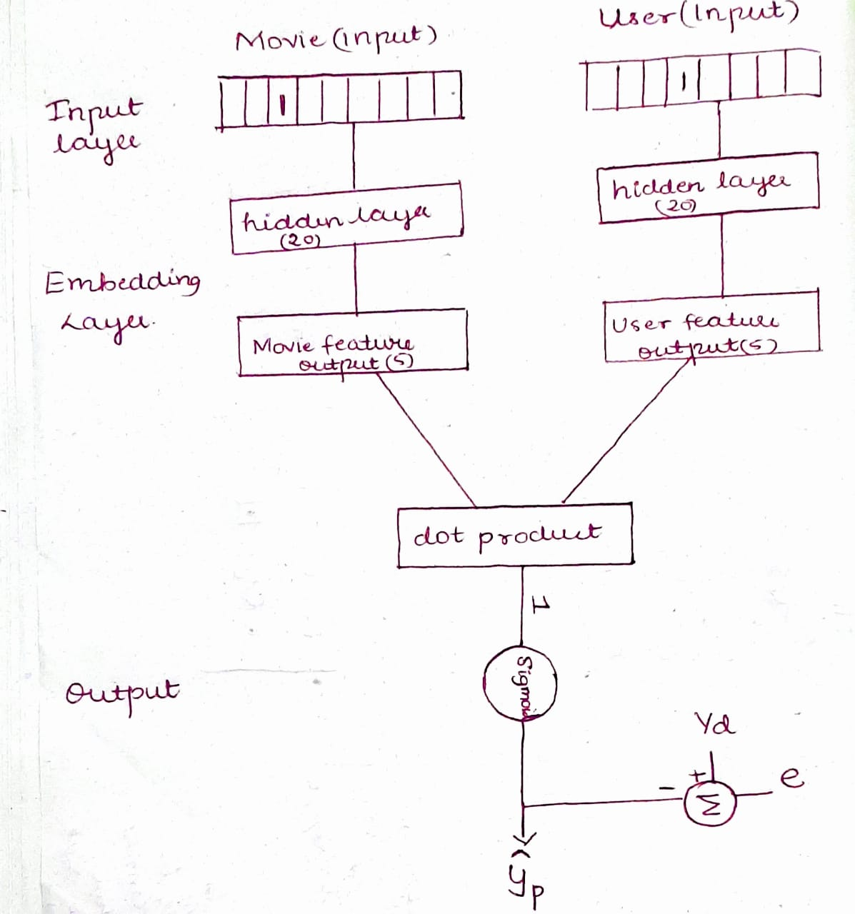
TRAINING MODEL :

Slide 26
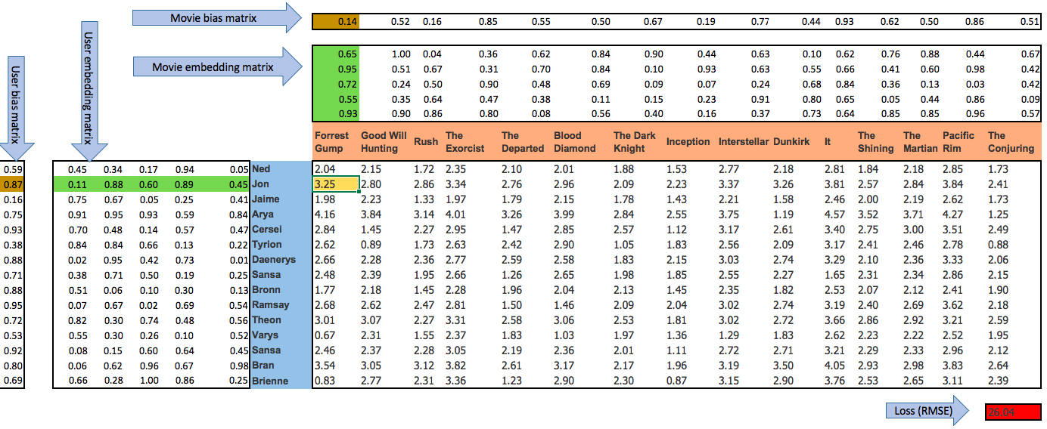

Slide 27
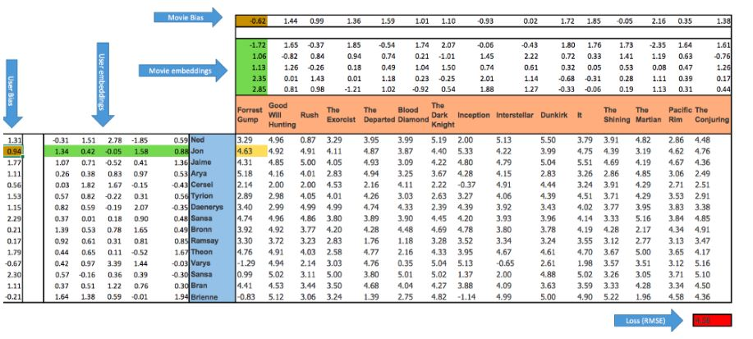

Slide 28
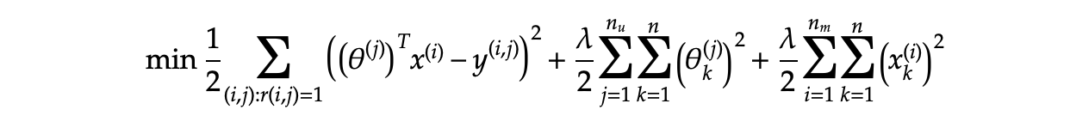
The cost function is thus minimised over the parameter vector for user(𝚹) and feature vector for movie(x). Y(i,j) is a matrix that corresponds to ratings given by user j on movie i.

Slide 29
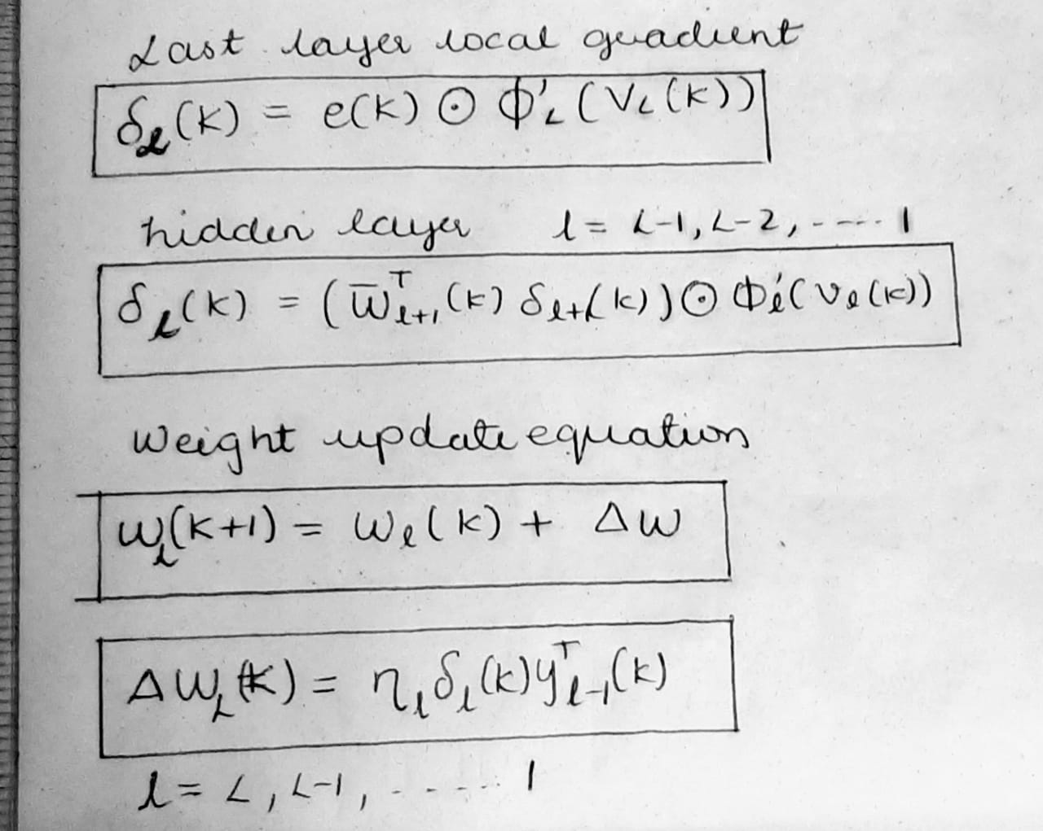
BACK PROPOGATION →

Slide 30
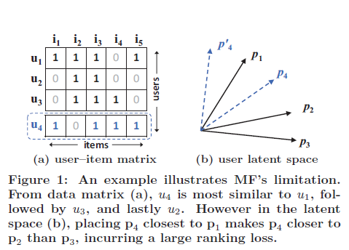
Disadvantage of MF

Slide 31
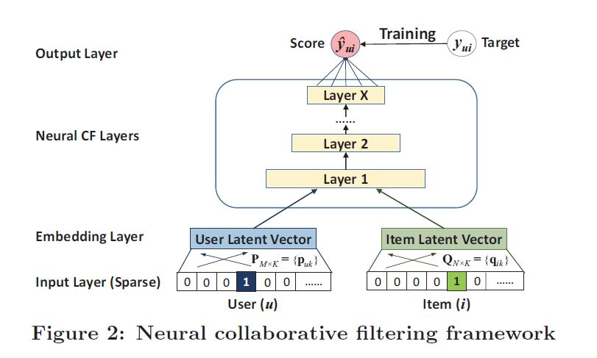
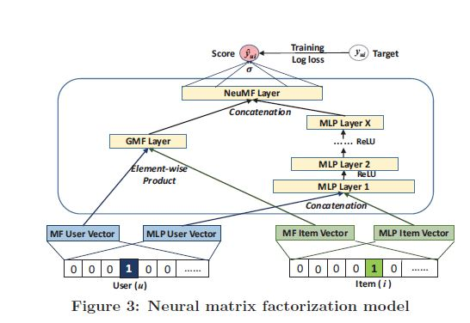
FURTHER ENHANCEMENT

Slide 32
REFERENCES
https://towardsdatascience.com/recommender-system-a1e4595fc0f0
https://arxiv.org/pdf/1708.05031.pdf
https://dl.acm.org/citation.cfm?id=2835837
https://www.onceupondata.com/2019/02/10/nn-collaborative-filtering/ *
https://medium.com/deep-systems/movix-ai-movie-recommendations-using-deep-learning-5903d6a31607
https://www.sciencedirect.com/science/article/pii/S0957417417302968
https://www.sciencedirect.com/science/article/pii/S0957417417302968
https://towardsdatascience.com/collaborative-filtering-and-embeddings-part-1-63b00b9739ce *
https://towardsdatascience.com/various-implementations-of-collaborative-filtering-100385c6dfe0
https://medium.com/analytics-vidhya/collaborative-filtering-a-sincere-perspicacity-ad034113878b
https://towardsdatascience.com/various-implementations-of-collaborative-filtering-100385c6dfe0 *
https://jovian.ml/aakashns/5bc23520933b4cc187cfe18e5dd7e2ed *
https://medium.com/ai-society/a-concise-recommender-systems-tutorial-fa40d5a9c0fa
https://grouplens.org/datasets/movielens/ (dataset) *

Slide 33
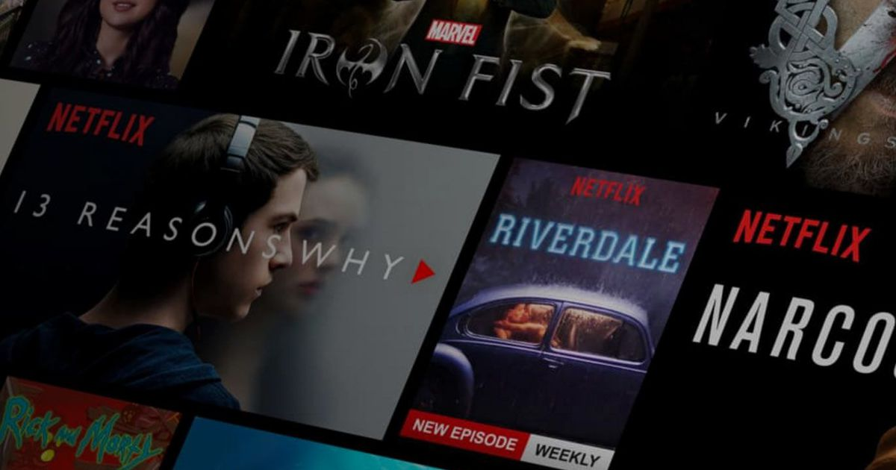
THANK YOU

